Slide 1
DGL-KE

Slide 2
What is DGL-KE
DGL-KE is a high performance, easy-to-use, and scalable package for learning large-scale knowledge graph embeddings.
The package is implemented on the top of Deep Graph Library (DGL)
and developers can run DGL-KE on CPU machine, GPU machine, as well as clusters with a set of popular models, including TransE, TransR, RESCAL, DistMulti, ComplEx, and RotateE.

Slide 3
Background

Slide 4
Background
A knowledge graph
mainly describes real world entities and their interrelations, organized in a graph,
defines possible classes and relations of entities in a schema,
allows for potentially interrelating arbitrary entities with each other
covers various topical domains.
Knowledge Graphs are often modeled as directed multigraphs.

Slide 5
Knowledge Graph
Facts
Mary and Tom are siblings and they both are are vegetarians, who like potatoes and cheese. Mary and Tom both work at Amazon. Joe is a bloke who is a colleague of Tom. To make the matter complicated, Joe loves Mary, but we do not know if the feeling is reciprocated.
Joe is from Quebec and is proud of his native dish of Poutine, which is composed of potato, cheese, and gravy. We also know that gravy contains meat in some form.
Link Prediction
Joe is excited to invite Tom for dinner and and has his sibling, Mary, in the invitation. His plans are doomed from get go as he is planning to serve the vegetarian siblings his favourite Quebecois dish, Poutine.
Oh! by the way, a piece of geography trivia: Quebec is located in a province of the same name, which in turn is located in Canada.

Slide 6
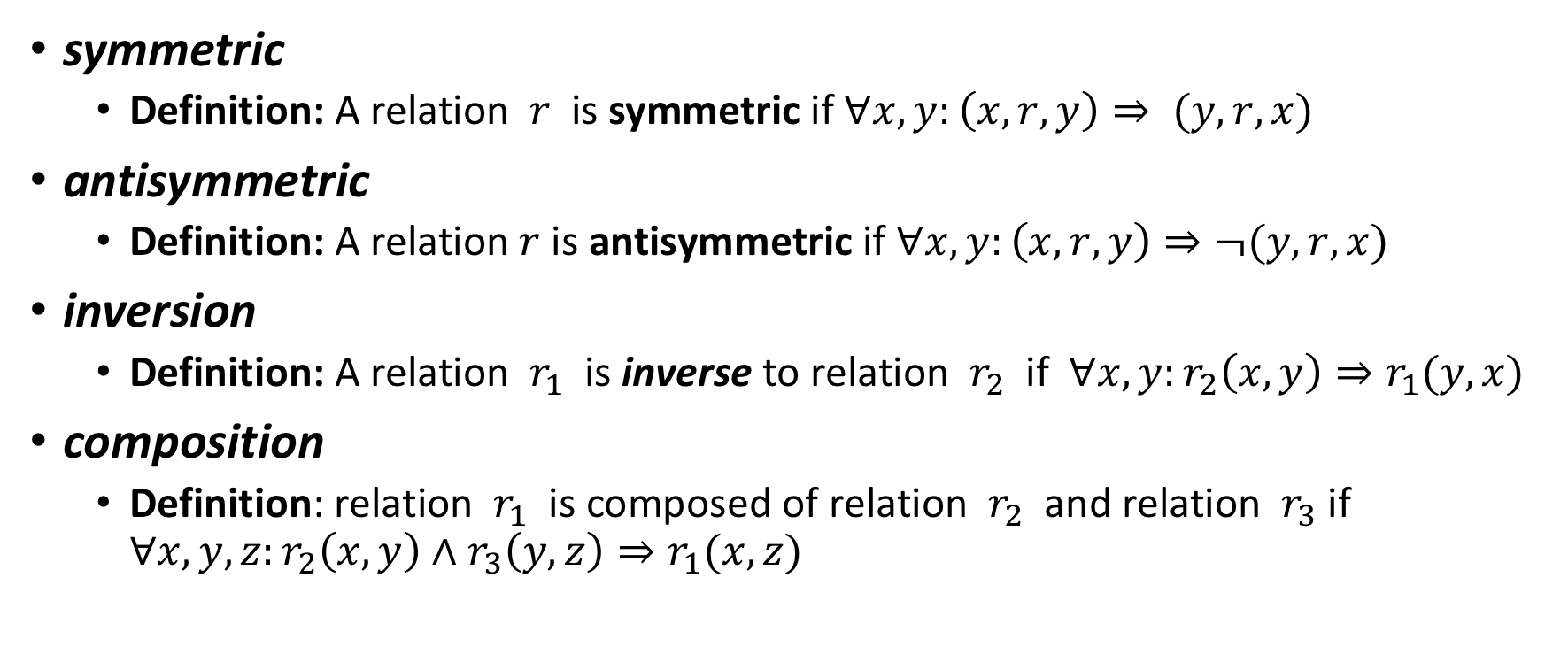
Different Types of Links
symmetric
Definition: A relation $r$ is symmetric if $∀x,y:\left(x,r,y\right)⇒ (y,r,x)$
antisymmetric
Definition: A relation $r$ is antisymmetric if $∀x,y:\left(x,r,y\right)⇒¬(y,r,x)$
inversion
Definition: A relation $r_{1}$ is inverse to relation $r_{2}$ if $∀x,y:r_{2}\left(x,y\right)⇒r_{1}(y,x)$
composition
Definition: relation $r_{1}$ is composed of relation $r_{2}$ and relation $r_{3}$ if $∀x,y,z:r_{2}\left(x,y\right)∧r_{3}\left(y,z\right)⇒r_{1}(x,z)$

Slide 7
Score Function
Each of the KGE has a score function that measures score for triplets of (head, relation, tail) that are valid and those, which are not.
KGE models tend to maximize the score for relations that hold true.
A list of score functions for KE papers implemented by DGL-KE

Slide 8
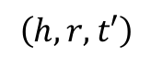
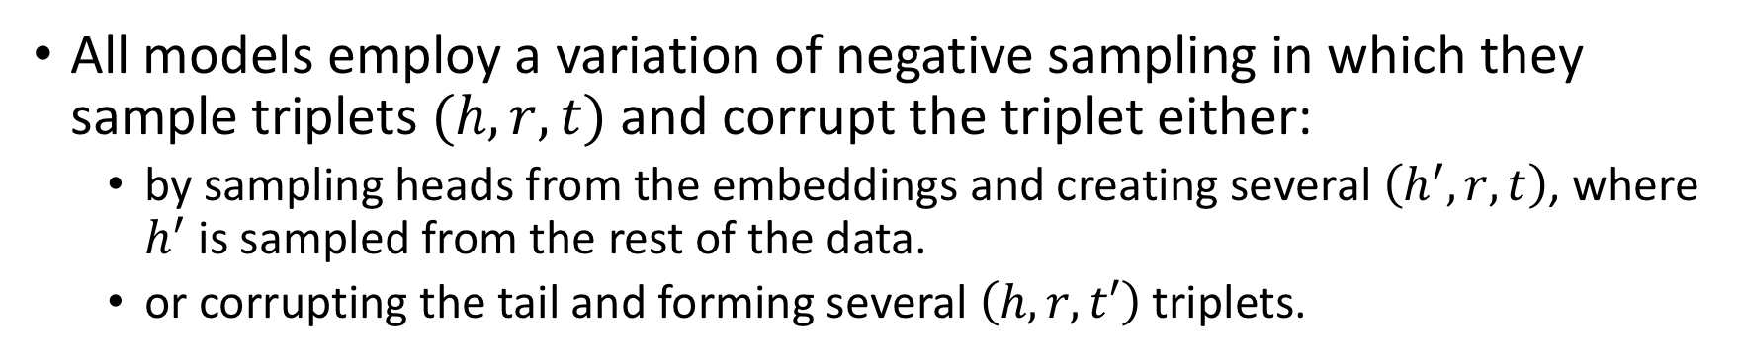
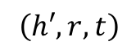
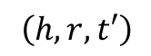
Training a KGE – Negative Sampling
All models employ a variation of negative sampling in which they sample triplets $(h, r, t)$and corrupt the triplet either:
by sampling heads from the embeddings and creating several $\left(h^{′}, r, t\right)$, where $h^{′}$is sampled from the rest of the data.
or corrupting the tail and forming several $\left(h, r, t′\right) \text{triplets}\text{. }$
$$\left(h, r, t′\right)$$
Poutine
contains
potato
Poutine
contains
Joe
$$\left(h, r, t′\right)$$
Tom
IsBrotherOf
Mary
Poutine
contains
Mary
$$\left(h′, r, t\right)$$
Tom
IsColleagueOf
Joe
Tom
contains
potato

Slide 9
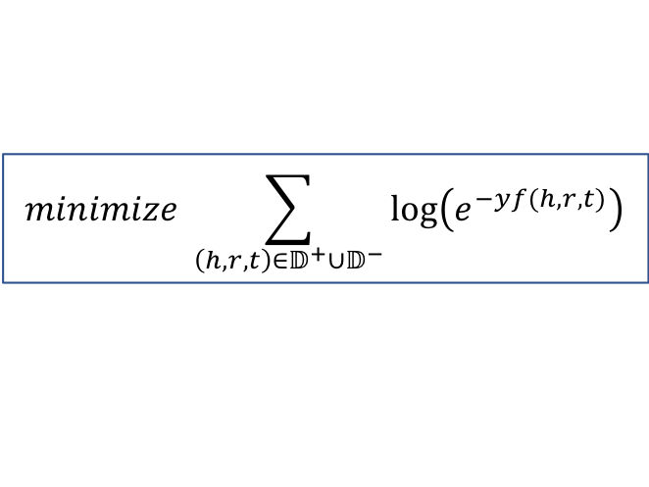
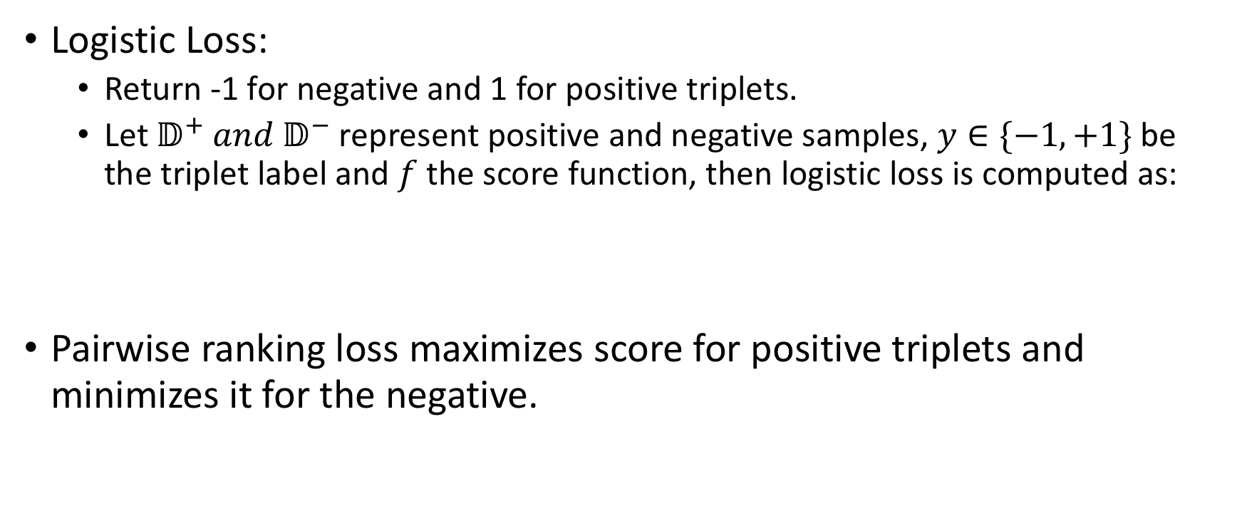
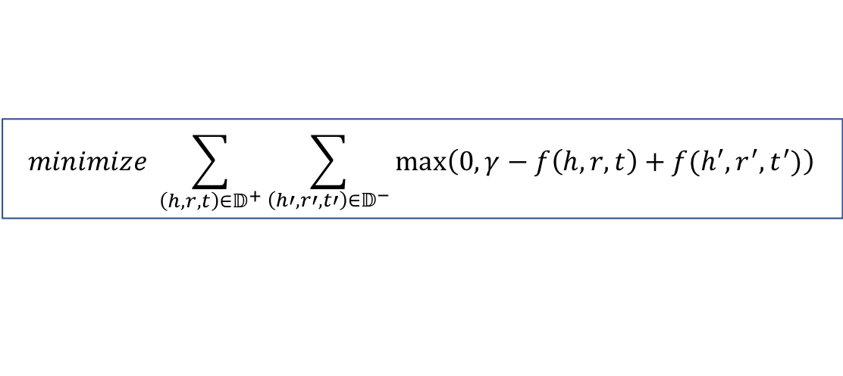
Training a KGE - Loss Function -
Logistic Loss:
Return -1 for negative and 1 for positive triplets.
Let $𝔻^{+} and 𝔻^{−}$ represent positive and negative samples, $y∈\{−1,+1\}$ be the triplet label and $f$the score function, then logistic loss is computed as:
Pairwise ranking loss maximizes score for positive triplets and minimizes it for the negative.
$$minimize \sum_{\left(h,r,t\right)∈𝔻^{+}∪𝔻^{−}}{\log\left(e^{−yf(h,r,t)}\right)}$$
$$minimize \sum_{\left(h,r,t\right)∈𝔻^{+}}{\sum_{\left(h′,r′,t′\right)∈𝔻^{−}}{\max\left(0, γ−f\left(h,r,t\right)+f(h^{′}, r^{′}, t^{′})\right)}}$$

Slide 10
DGL-KE

Slide 11
DGL-KE Environment

Slide 12
Challenges for KGE
Real-world problems have millions of nodes and billions of edges, while relationships are of different type and both nodes and relations have different sets of features. This results in separate problems:
Size
Sparsity
Effective distribution.

Slide 13
Optimization in DGL-KE
DGL-KE accelerated KGE training on knowledge graphs with millions of node and billions of edges using various deployment architectures and hardware. Parallelism is achieved through several optimizations:
Increased data locality.
Reduced communication overhead.
Overlapped computations with memory access.
High operation efficiency.

Slide 14
Hardware Configurations
Multi CPU core.
Multi-GPU
Multi machine in a CPU/GPU cluster.

Slide 15
Training Process
Preprocessing Step to partition the knowledge base.
Assigning a disjoint set of triplets to a process to allow mini-batch training to run independently in each process.
Minibatch Training .
Samples triplets from a local partition to create a mini-batch and constructs negative samples.
Fetches entity and relation embeddings that are involved in the minibatch from global embedding trnsors.
Performs forward computation and backpropagation to compute the gradients of the embeddings.
Applies gradients to update the embedgings involved in the mini-batch.

Slide 16
Graph Partitioning

Slide 17
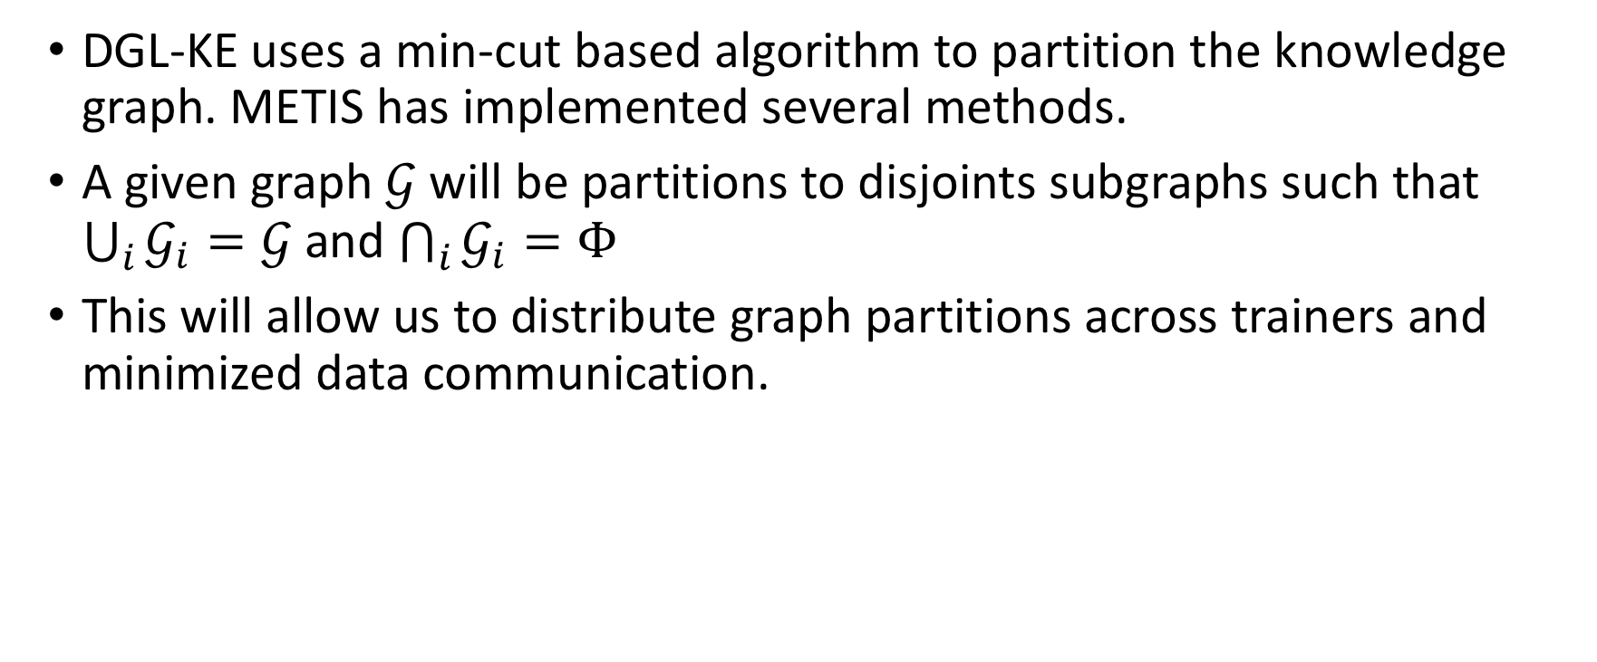
Partitioning the Graph
DGL-KE uses a min-cut based algorithm to partition the knowledge graph. METIS has implemented several methods.
A given graph $𝒢$will be partitions to disjoints subgraphs such that $\bigcup_{i}{𝒢_{i}=𝒢}$and $\bigcap_{i}{𝒢_{i}=Φ}$
This will allow us to distribute graph partitions across trainers and minimized data communication.
Reminder: in distributed graph computation, nodes are associated process complexity and and edges are associated with data communication; therefore any graph partitioning algorithm should strive to create clusters of nodes with high cohesion and minimize cross cluster edges.

Slide 18
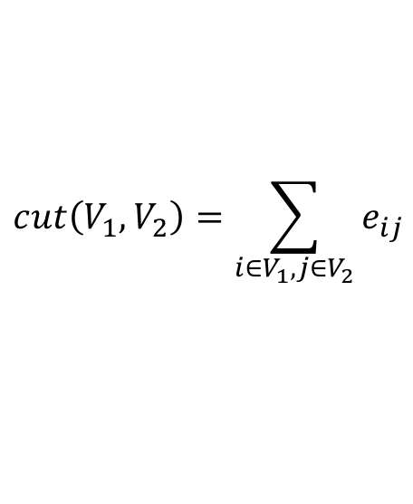
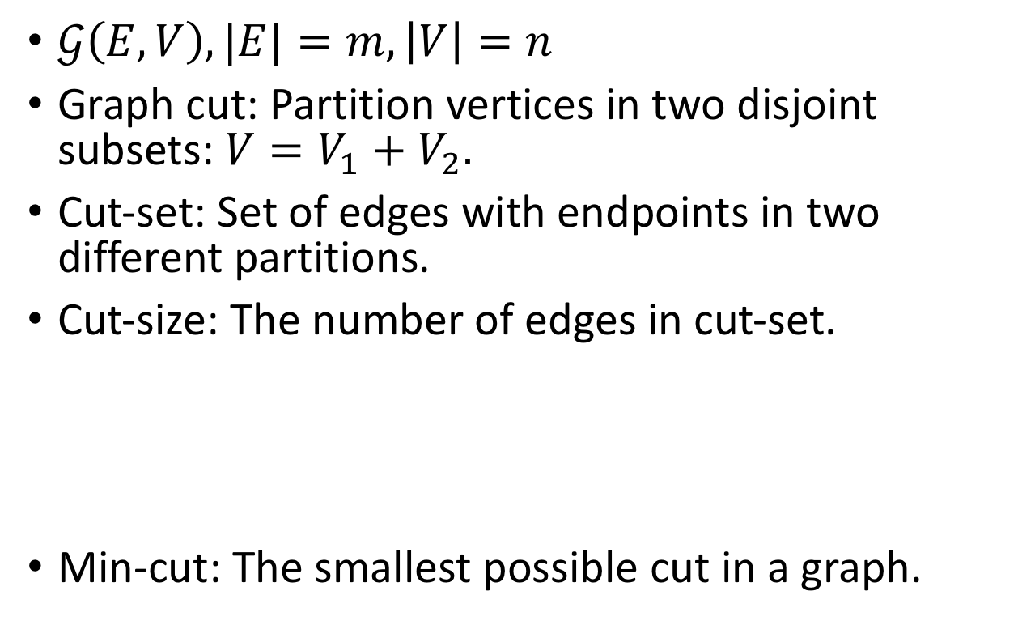
Randomized Min-Cut
$𝒢\left(E,V\right), |E|=m, \left|V\right|=n$
Graph cut: Partition vertices in two disjoint subsets: $V=V_{1}+V_{2}.$
Cut-set: Set of edges with endpoints in two different partitions.
Cut-size: The number of edges in cut-set.
Min-cut: The smallest possible cut in a graph.
$$cut\left(V_{1},V_{2}\right)=\sum_{i∈V_{1}, j∈V_{2}}{e_{ij}}$$

Slide 19
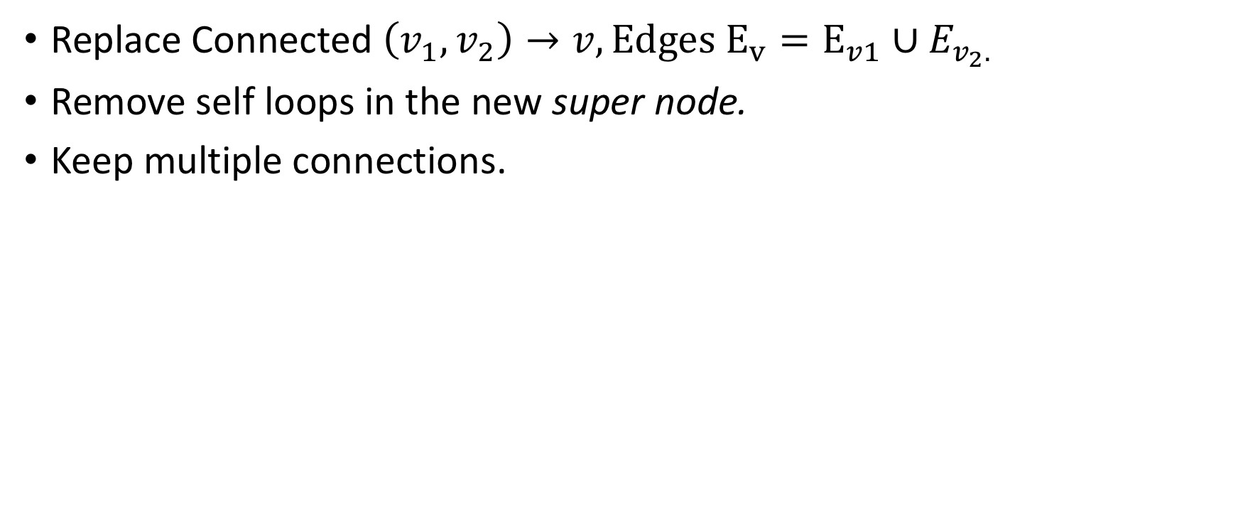
Vertex Contraction
Replace Connected $\left(v_{1},v_{2}\right)→v, Edges E_{v}=E_{v1}∪E_{v_{2}.}$
Remove self loops in the new super node.
Keep multiple connections.
delete

Slide 20
Vertex Contraction
Replace Connected $\left(v_{1},v_{2}\right)→v, Edges E_{v}=E_{v1}∪E_{v_{2}.}$
Remove self loops in the new super node.
Keep multiple connections.

Slide 21
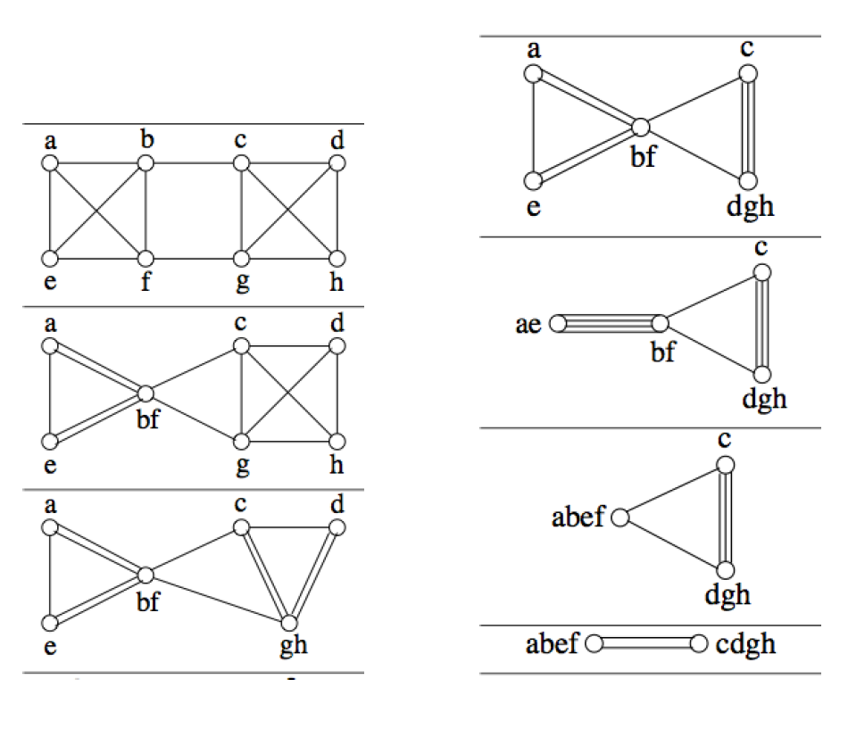
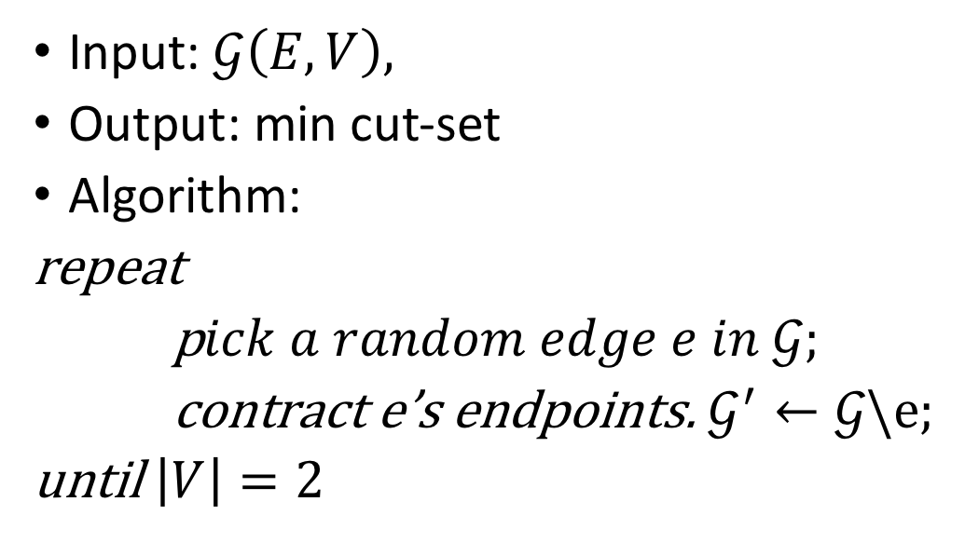
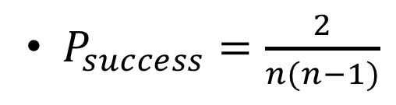
David Karger’s Randomized Min Cut
Input: $𝒢\left(E,V\right),$
Output: min cut-set
Algorithm:
repeat
p$ick a random edge e in 𝒢;$
contract e’s endpoints. $𝒢^{′}←𝒢\backslash e;$
until $\left|V\right|=2$
$P_{success}=\frac{2}{n(n−1)}$

Slide 22
Randomized min-cut

Slide 23
Distribution of Data

Slide 24
Two Types of Data
Knowledge graph Structure
Entity and relation embeddings

Slide 25
Data Distribution on Hardware Config
Multicore CPU:
KG Structure on the CPU shared memory.
Entity embeddings on the CPU shared memory.
Relation embeddings on the CPU shared memory.

Slide 26
Data Distribution on Hardware Config
Multi GPU:
KG Structure on the CPU shared memory.
Entity embeddings on the CPU shared memory.
Relation embeddings on the GPU memory.

Slide 27
Data Distribution on Hardware Config
Distributed Training:
Deploy KV-Store to store entity and relation embeddings.
KV-Store automatically partitions the embeddings and strides them across servers.
Trainer process uses push and pull APU to read the embeddings from the kv-store.
Each trainer machine stores a partition of the graph.
Graph structure is shred across all trainer processes in a given machine.

Slide 28
Negative Sampling

Slide 29
Constructing Negative Samples
DGL-KE constructs a large number of negative samples for each triplet per batch.
Sampling is performed on CPU and computation is offloaded to DGL.
Corrupting triplets is conducted collectively per batch.

Slide 30
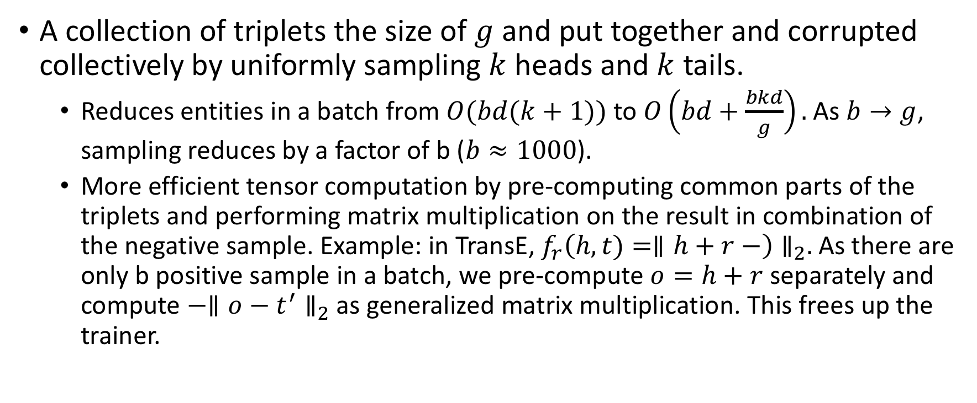
Corrupting Triplets
A collection of triplets the size of $g$ and put together and corrupted collectively by uniformly sampling $k$ heads and $k$ tails.
Reduces entities in a batch from $O(bd(k+1))$ to $O\left(bd+\frac{bkd}{g}\right).$As $b→g$, sampling reduces by a factor of b ($b≈1000$).
More efficient tensor computation by pre-computing common parts of the triplets and performing matrix multiplication on the result in combination of the negative sample. Example: in TransE, ${f_{r}\left(h,t)=∥h+r−\right)∥}_{2}.$As there are only b positive sample in a batch, we pre-compute $o=h+r$ separately and compute $−∥o−t^{′}∥_{2}$ as generalized matrix multiplication. This frees up the trainer.

Slide 31
More effective Negative Samples
minibatch
Uniform negative samples create easy negative samples as it does not into account degree of a node.
We additionally perform negative sampling proportionally to the degree of a node to create hard negative samples.
In order to reduce traffic, hard negative samples are performed through uniform sampling inside a minibatch.
In distributed training, sampling is conducted from the local METIS partition.
1
2
1
3
2
4
4
5
1
4
1
5
2
3
2
5
1
3
5
4
…

Slide 32
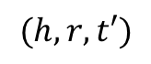
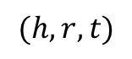
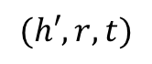
minibatch
1
2
1
6
9
2
1
3
1
7
6
3
1
4
1
8
7
4
1
5
1
9
4
5
2
6
2
1
5
6
2
7
2
5
3
7
3
8
3
9
1
8
4
9
4
2
2
9
$$(h,r,t)$$
$$(h,r,t′)$$
$$(h′,r,t)$$
positive triplets (left) are the basis of forming a minibatch. CPU based processes corrupt the triplets within minibatches by uniformly sampling from set of tails for tail corruption. The number of samples per head is proportional to degree of each node. For instance in this example we have 4 positive samples with $h=1.$We, therefore, have sampled uniformly 4 corrupted tails from the set of tail values. The same is applicable to corrupting heads. This results in a larger number of negatively sampled training instances for triplets with $h=1$.

Slide 33
Partitioning Relations

Slide 34
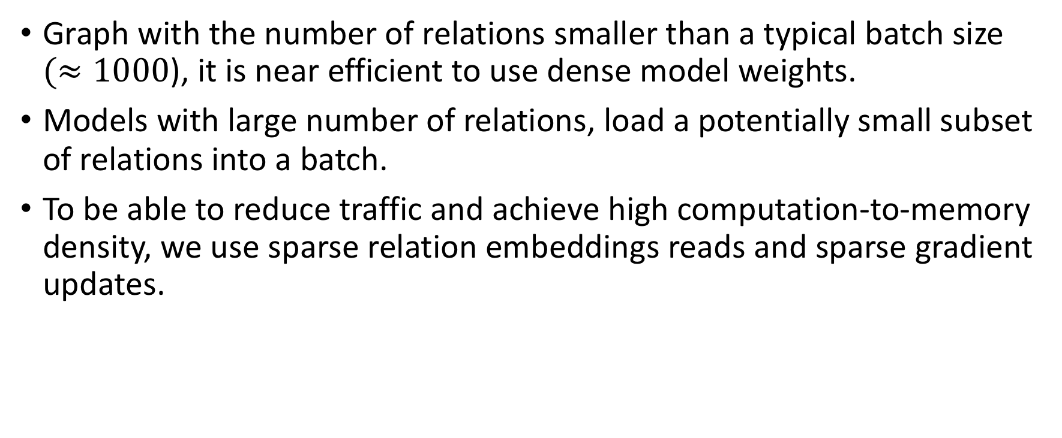
Dense or Sparse?
Graph with the number of relations smaller than a typical batch size $(≈1000$), it is near efficient to use dense model weights.
Models with large number of relations, load a potentially small subset of relations into a batch.
To be able to reduce traffic and achieve high computation-to-memory density, we use sparse relation embeddings reads and sparse gradient updates.

Slide 35
Partitioning Relations
Equally load-balance triplets and relations among the partitions.
Minimize the number of distinct relations that are assigned to a partition to minimize relation-related data traffic.

Slide 36
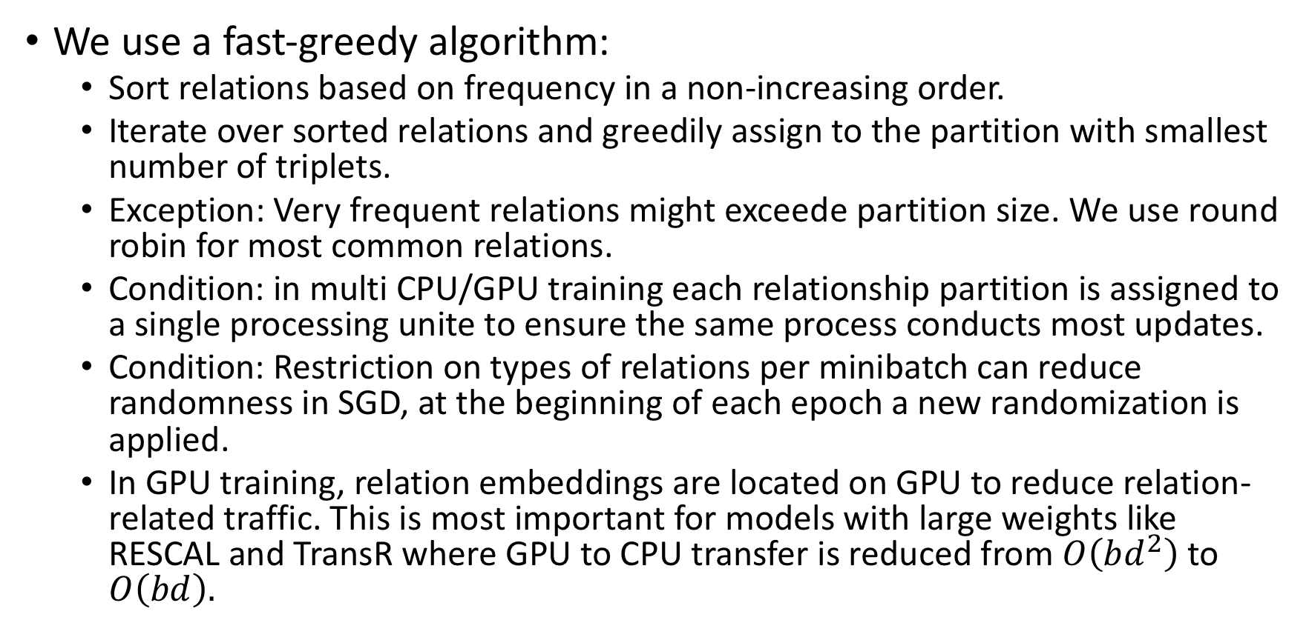
Partitioning Relation Algorithm
We use a fast-greedy algorithm:
Sort relations based on frequency in a non-increasing order.
Iterate over sorted relations and greedily assign to the partition with smallest number of triplets.
Exception: Very frequent relations might exceede partition size. We use round robin for most common relations.
Condition: in multi CPU/GPU training each relationship partition is assigned to a single processing unite to ensure the same process conducts most updates.
Condition: Restriction on types of relations per minibatch can reduce randomness in SGD, at the beginning of each epoch a new randomization is applied.
In GPU training, relation embeddings are located on GPU to reduce relation-related traffic. This is most important for models with large weights like RESCAL and TransR where GPU to CPU transfer is reduced from $O\left(bd^{2}\right)$ to $O\left(bd\right).$

Slide 37
Overlapping Gradient Update

Slide 38
GPU Idling
In GPU training, minibatch computation runs on CPU while gradient computation is conducted on GPU.
Often in deep learning we encounter GPU idling as GPUs are waiting for the batch to be loaded before they can process it.
To reduce idling, while the trainer process, we begin minibatch computation on CPU for the next minibatch independently.
By the time the trainer processes has completed the update process, the next minibatch is already processed and the trainer process can begin the computing the gradient on the next batch.
Drawback: Theoretical chance of computation on stale gradient.
trainer

Slide 39
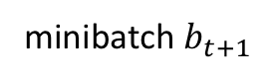
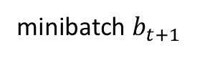
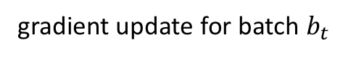
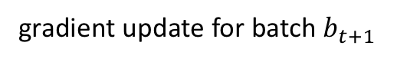
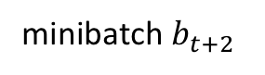
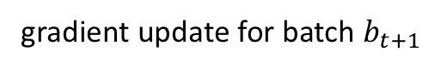
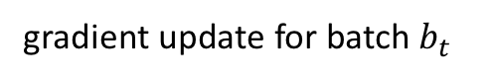
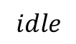
GPU Idling
CPU
CPU
CPU
idle
minibatch $b_{t+1}$
$$idle$$
time
GPU
gradient update for batch $b_{t}$
GPU
idle
GPU
gradient update for batch $b_{t+1}$
CPU
CPU
minibatch $b_{t+1}$
minibatch $b_{t+2}$
time
GPU
gradient update for batch $b_{t}$
GPU
gradient update for batch $b_{t+1}$
trainer

Slide 40
Splitting Gradient Updates
Number of entities are much larger than the number of relations. To ensure GPU is not idling while entity embeddings are updated:
Relation embedding updates are performed by trainer process.
Entity embeddings are performed by a dedicated process per trainer.

Slide 41
Importance of Gradient Update Overlapping
Overlapping Gradient updates provide a 40% speedup for most of the KGE models on Freebase dataset.

Slide 42
Methodology

Slide 43
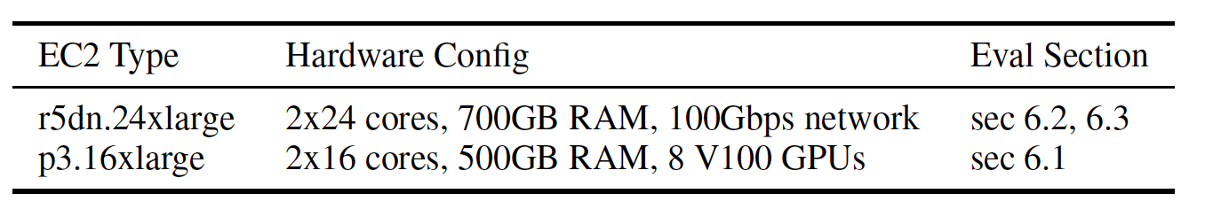
Hardware

Slide 44
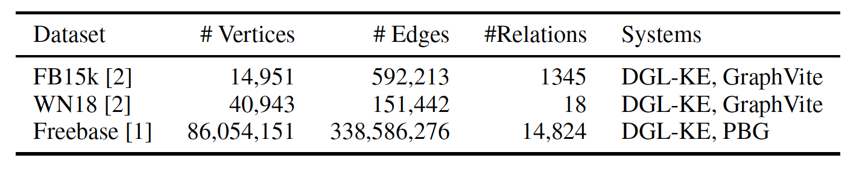
Datasets
FB15k and Freebase is a Freebase based Freebased Knowledge Graph Dataset.
WN18 is derived from WordNet.
FB15k and WN18 are standard benchmarking datasets for KGE.

Slide 45
Evaluation Methodology
We measures the performance of the model based on link prediction task.
Freebase split: 5% validation, 5% test, and 90% training.
FB15k, based on RotateE and roughly 10% for test, roughly 8% for validation, and roughly 82% for training.
WN18: Based on RotateE and 3.33 for test, 3.33 for validation and 93.34 for training.

Slide 46
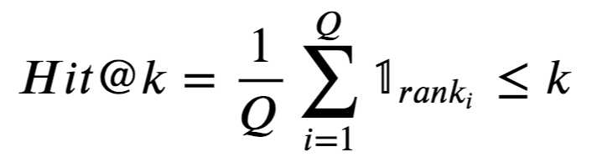
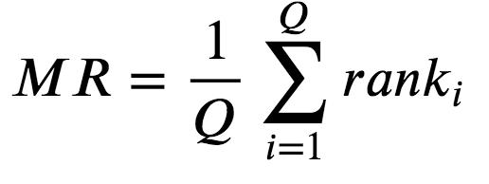
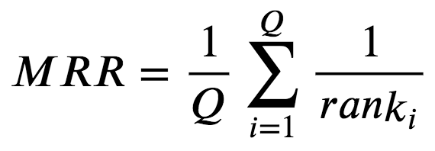
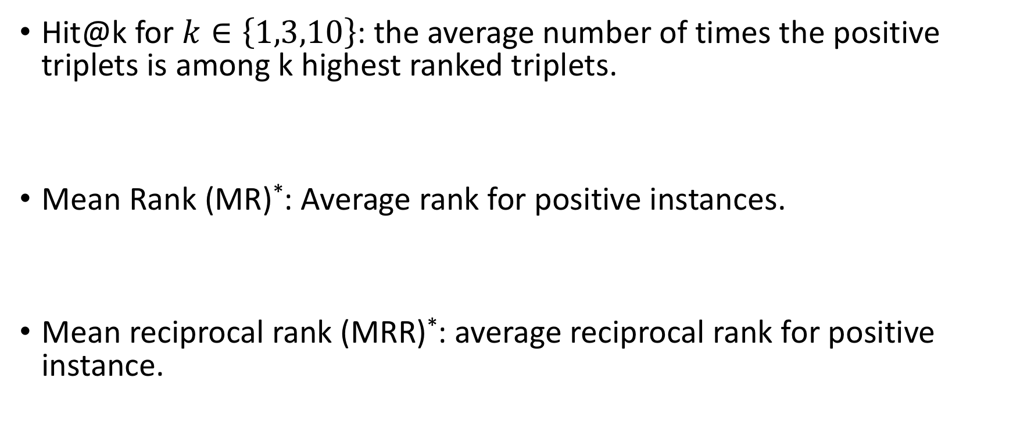
Metrics
Hit@k for $k∈\left\{1,3,10\right\}$: the average number of times the positive triplets is among k highest ranked triplets.
Mean Rank (MR)*: Average rank for positive instances.
Mean reciprocal rank (MRR)*: average reciprocal rank for positive instance.
*: measure for evaluating any process that produces a list of possible responses to a sample of queries, ordered by probability of correctness.

Slide 47
Results

Slide 48
Speed of of different optimizations

Slide 49
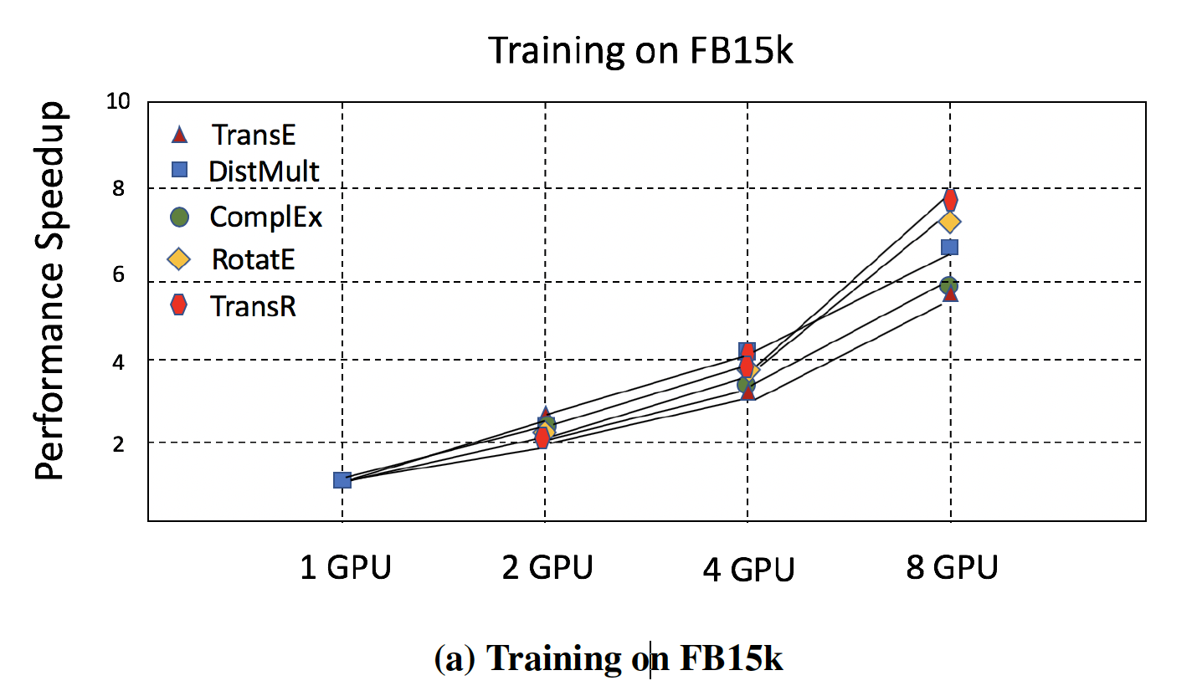
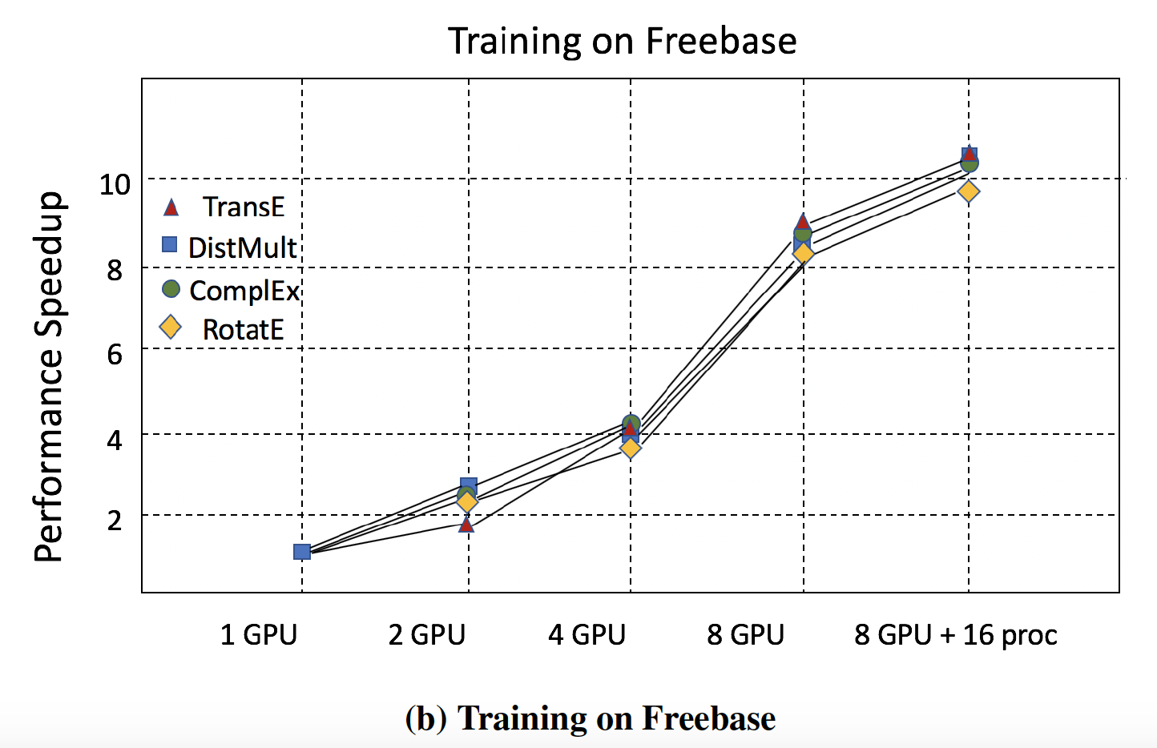
Speedup on multi-GPU training§

Slide 50
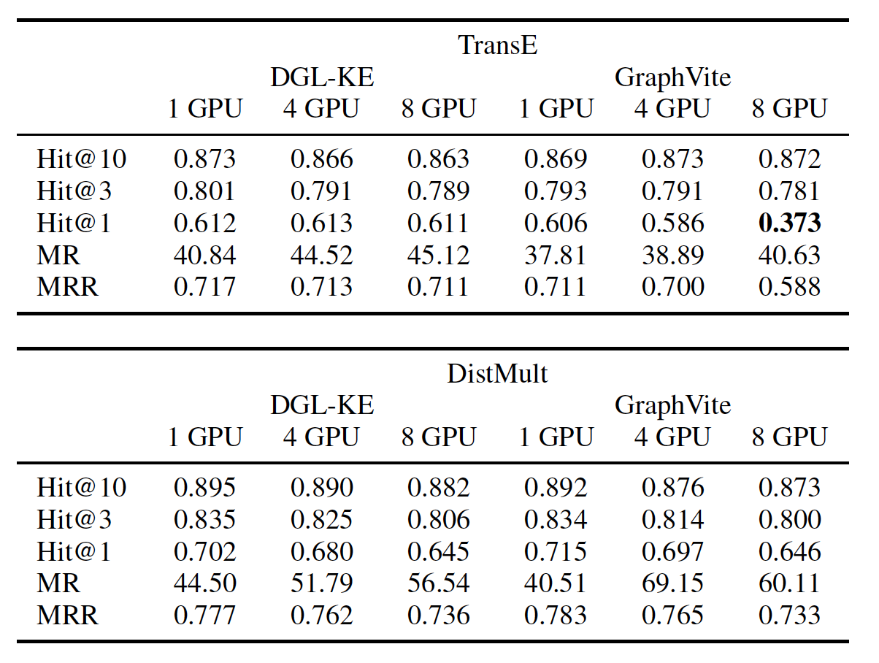
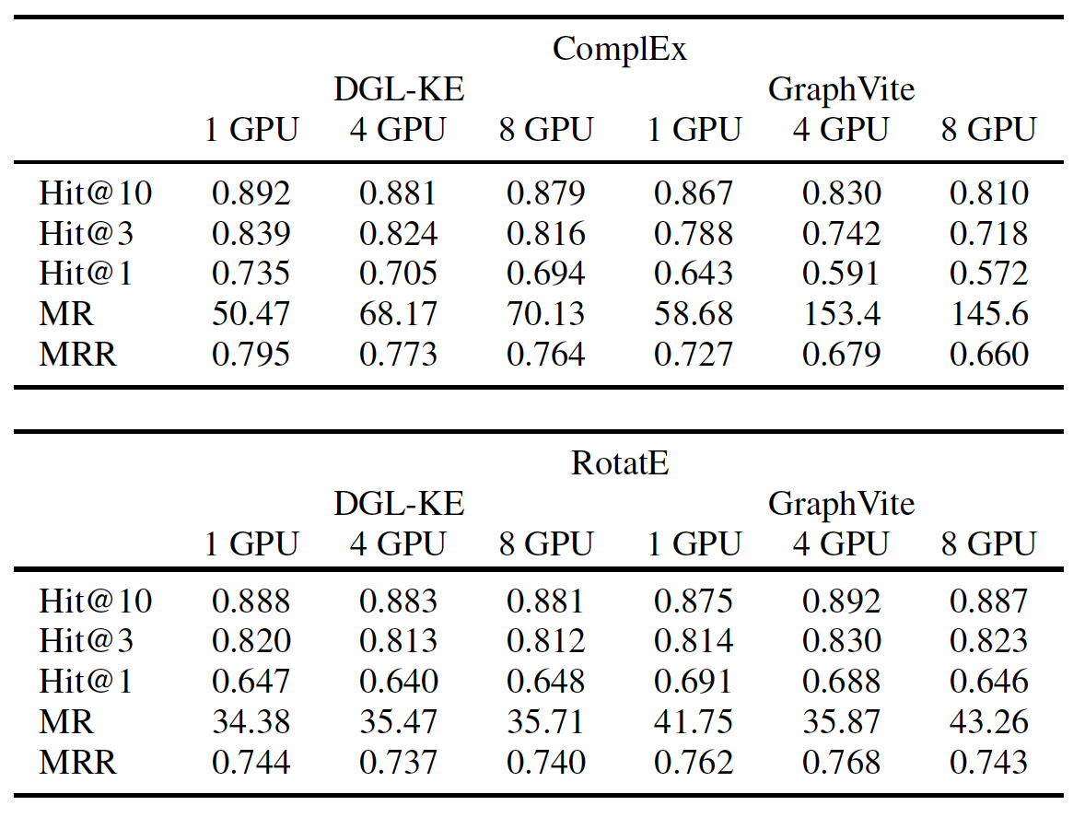
Accuracy vs Graph Vite – FG15k

Slide 51
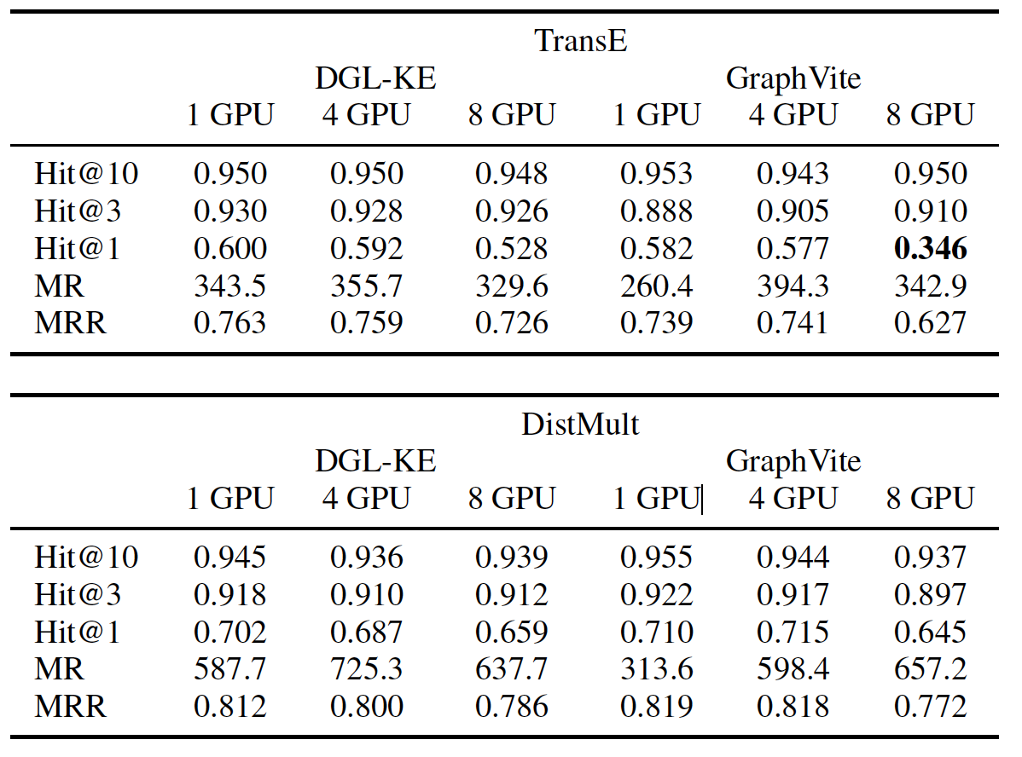
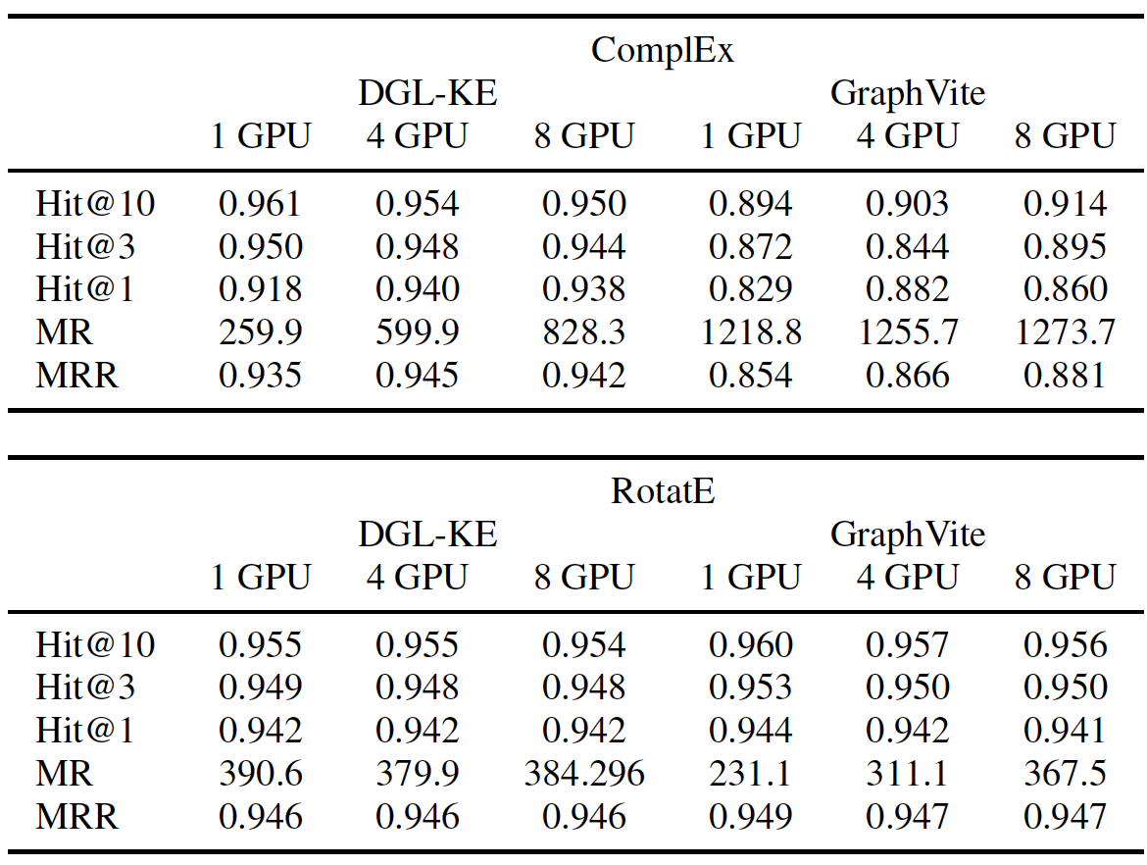
Accuracy vs Graph Vite – WN18

Slide 52
Thank You

